Slide 1
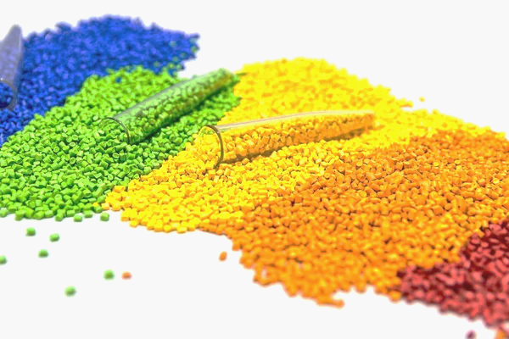
Polypropylene Machine Learning “Soft Sensor”
Drew Perry, Michael Crapse, Tanzim Mostafa
MATH 4463, 25 March 2024

Slide 2

Introduction/Background
Plastic production, polypropylene in particular.
Created in slurry reactors.
Created from propylene and ethylene monomers.
Introduced to a catalyst, hydrogen introduced to stop chain growth.
Important that the polypropylene chains are the correct length.
Length can be determined to an appropriate degree using the melt flow rate.
Machine Learning in Python
Various Python packages used
Pandas
Numpy
Seaborn
MatPlotLib
SKLearn

Slide 3
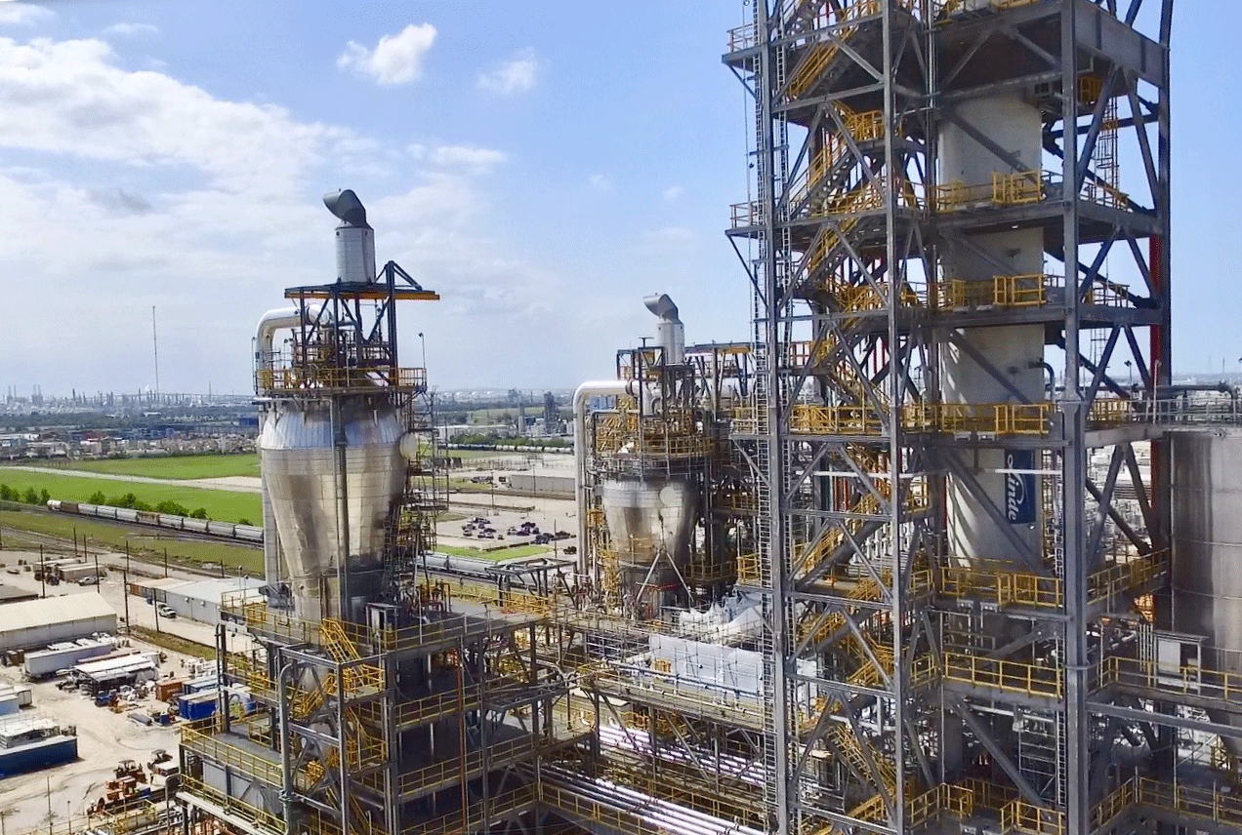
Goals of Research
Determine from readily available variables an approximate range of the melt flow rate to reduce the frequency of manual samples taken.
Also known as a “soft sensor”.
Variables provided are:
Propylene Feed Rate (C3)
Hydrogen to Propylene Ratio (H2R)
Reactor Pressure (Pressure)
Reactor Bed Level (Level)
Ethylene Flow Rate (C2)
Catalyst Feed Rate (Cat)
Reactor Temperature (Temp)
Melt Flow Rate (MFR)

Slide 4
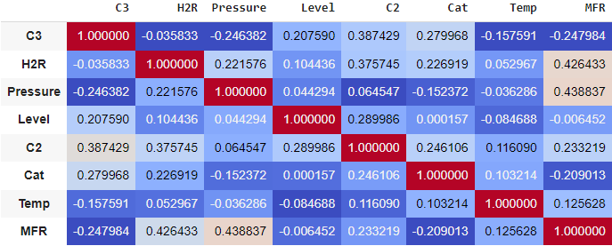
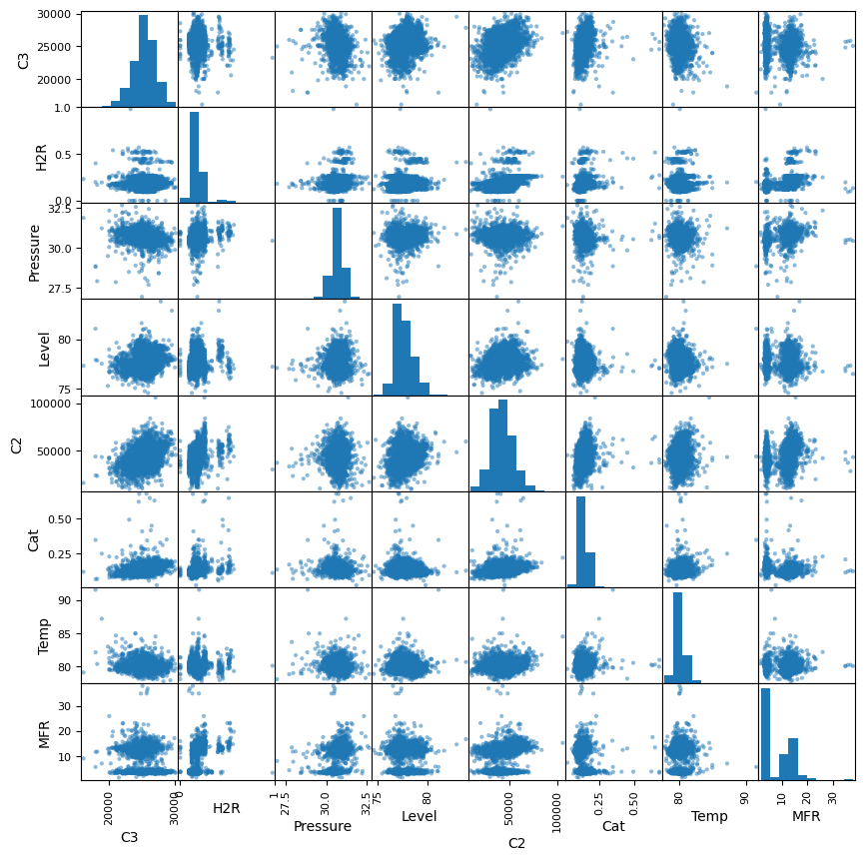
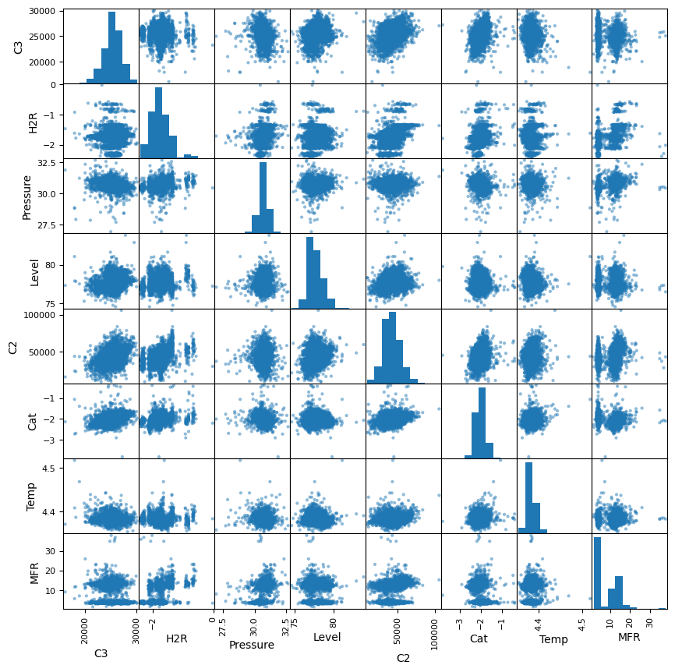
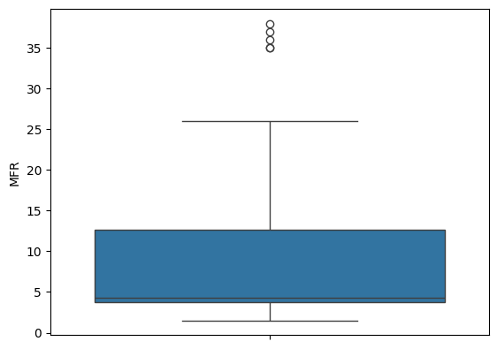
Methodology 1
Observe and clean data
Used the .describe, .skew, .corr methods, along with scatterplot matrix and box and whisker plots. Checked correlation of variables, removed missing variables.
Many variables found to be quite skewed (±0.75). For right skewed, natural log taken. (Cat, H2R, Temp, and MFR) This improved skewness and produced better results.
Only outliers removed were H2R=0.

Slide 5
Methodology 1 Cont.
Linear models produced using sklearn.linear_model Python module.
Models produced for initial x values, log x values, for both initial and log y values (MFR).
Used with full dataset to get an idea of performance
Using train_test_split from sklearn.model_selection, split of 0.8 train, 0.2 test, same random state to check for overfitting.
Followed up by doing the same but dropping one x variable each time.
Using train_test_split from sklearn.model_selection, split of 0.8 train, 0.2 test, various random states.
Used for all four above situations, with random states 0 through 10,000, tracking best and average MSE and R² values.
MSE not really used later in this methodology, as taking the log of MFR means comparing to models without using MSE is not really possible. For example, similar performing models by R^2 had an MSE of 3.64 without the log and 0.45 with.

Slide 6
Results 1
Linear models produced using sklearn.linear_model Python module.
Full Dataset Models
R² Values: Initial x, y, 0.423; Initial x, log(y), 0.431; Log(x), initial y, 0.492; Log(x), log(y), 0.514
Using train_test_split from sklearn.model_selection, split of 0.8 train, 0.2 test, same random state to check for overfitting.
Train, Test R²: Initial x, y, 0.433, 0.368; Initial x, log(y), 0.443, 0.365; Log(x), initial y, 0.488, 0.503; Log(x), log(y), 0.520, 0.489.
Followed up by doing the same but dropping one x variable each time. Each performed worse, though dropping Level or Temp produced close results.
Our model does not appear particularly overfit by these two tests.
Using train_test_split from sklearn.model_selection, split of 0.8 train, 0.2 test, various random states.
Random states 0 through 10,000, tracking best and average MSE and R² values.
Max, Average R² Values: Initial x, y, 0.569, 0.415; Initial x, log(y), 0.543, 0.420; Log(x), initial y, 0.632, 0.488; Log(x), log(y), 0.623, 0.508.

Slide 7
Methodology 2
Analyze
Dataset profiler
Essentially the pandas DataFrame methods: describe, info, corr, head, tail, etc.
Visualize
Visualize relationships through scatter plot matrix
Visualize potential outliers through box-and-whisker plots
Prepare
Remove potential outliers from the box-and-whisker plot
Remove bias through scaler (Editor Note: no need to do RobustScaler since outliers have been resolved)
Train and Test
Choose models
Visualize and analyze effectiveness

Slide 8
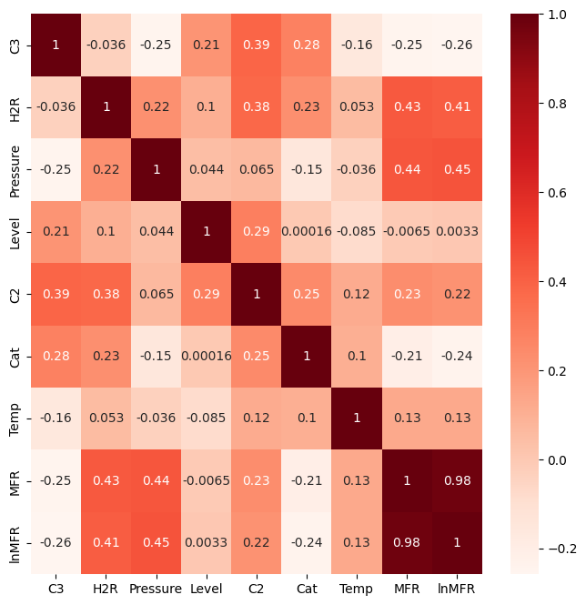
Methodology 2 Analyze Dataset
Used ydata_profiling to analyze the dataset.
The dataset has the following characteristics:
A total of 2,564 rows from initial dataset
Contains 2,484 rows after removing 80 rows with missing values
All columns contain real number values except date and time
MFR has highest correlation with H2R and Pressure

Slide 9
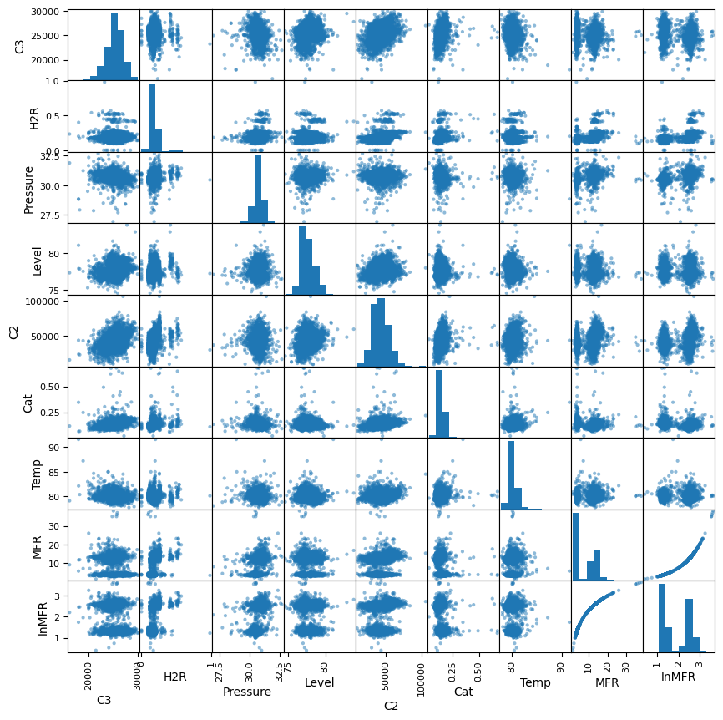
Methodology 2 Visualize Dataset
The scatter plot matrix shows no obvious patterns or relationships.
Except, there seems to be two groups for the MFR histogram.
Splitting the MFR column into two groups and graphing them together may provide further insights into the dataset.

Slide 10
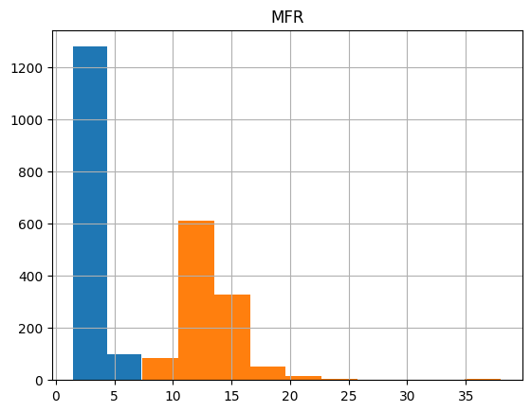
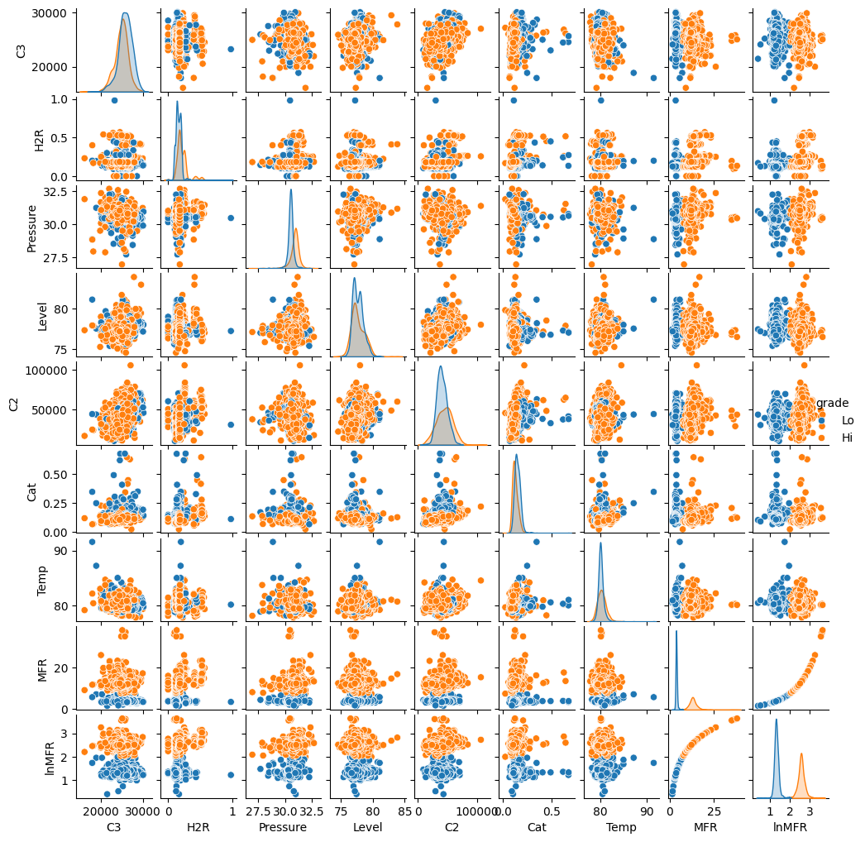
Methodology 2 Visualize Dataset

Slide 11
Methodology 2 Prepare Dataset
Prepared the dataset for training and testing.
Removed 80 rows with missing values.
Added natural log of MFR column and removed initial MFR column to reduce skewness and improve model performance.
Removed date and time column to avoid non-numerical data.
Removed potential outliers and visualized difference.
Used sklearn StandardScaler to remove potential bias from large differences in ranges between the dataset columns.
Notes:
Standard scaler was used instead of a robust scaler since potential outliers have already been manually removed.

Slide 12
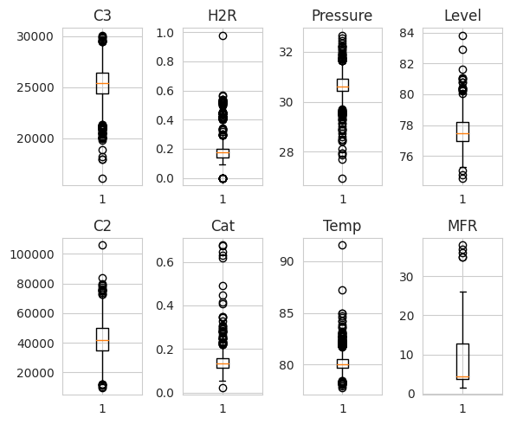
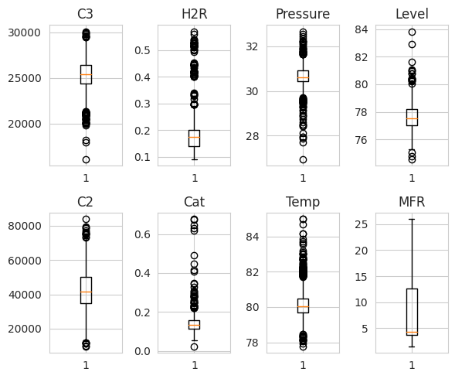
Methodology 2 Prepare Dataset
Removed potential outliers from H2R, C2, Temp, and MFR, leaving 2,464 rows.
On the left is the plot before removal, and on the right is the plot after removal.
Notes:
Removing entries like this can have unforeseen consequences. A professional in polypropylene production should be consulted for greater understanding of these potential outliers.

Slide 13
Methodology 2 Training and Testing
The dataset was split into two sets where 80% was used for training and 20% was used for testing.
Initial training and testing was conducted based on variables that have the greatest impact on MFR.
Produced numerical and visual results based on linear and non-linear regression models.

Slide 14
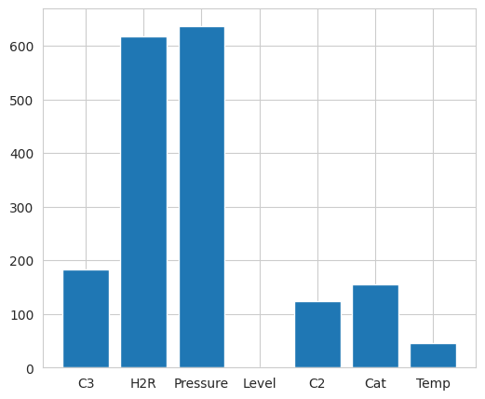
Methodology 2 Train and Test Dataset
Used sklearn SelectKBest to discover which variables impact MFR.
Two variables, H2R and Pressure, have the greatest impact on MFR.
Initial training, testing, and visualizing are based on these two variables to gain a greater understanding of the final model.

Slide 15
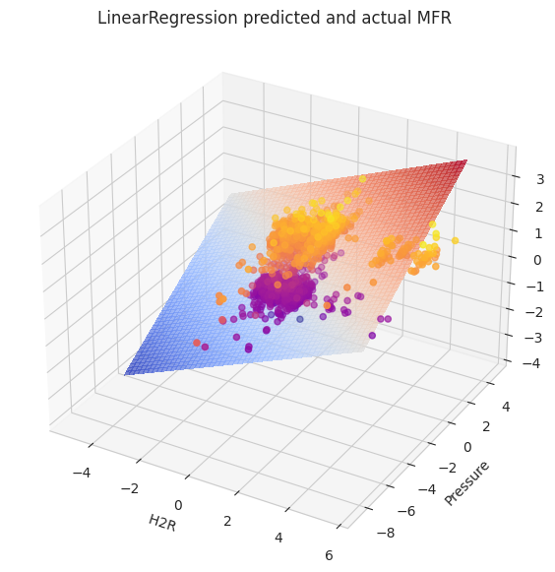
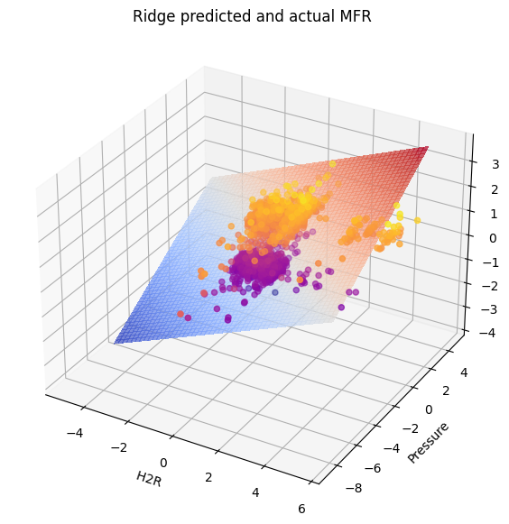
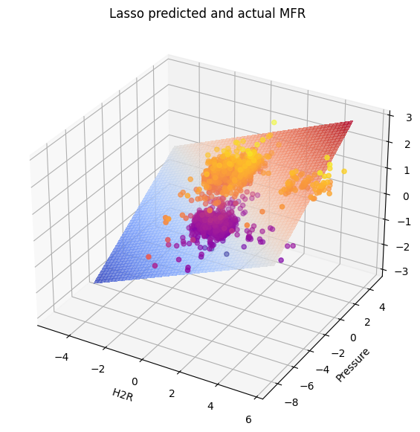
Results 2
Linear regression models with average R² scores:
Testing set: 0.44832 (Linear), 0.44834 (Ridge), and 0.39741 (Lasso)
Training set: 0.45907 (Linear), 0.45907 (Ridge), and 0.40341 (Lasso)

Slide 16
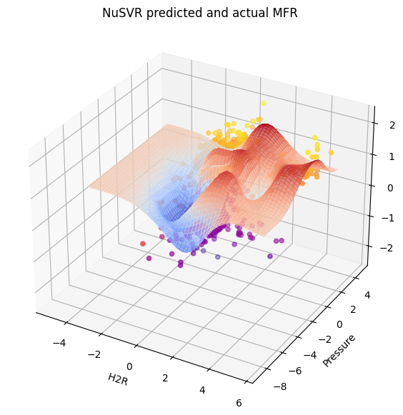
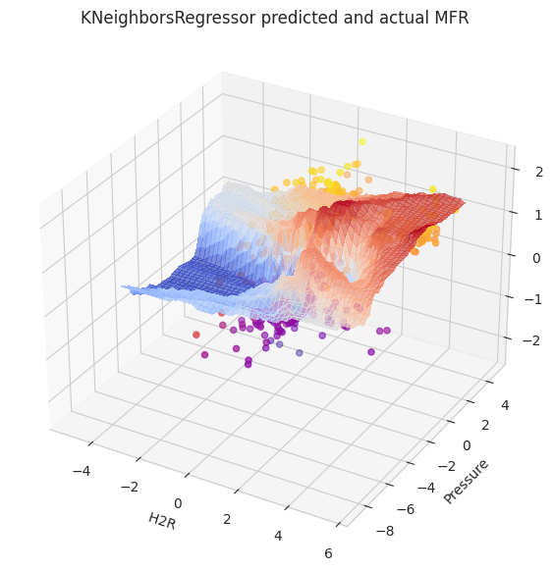
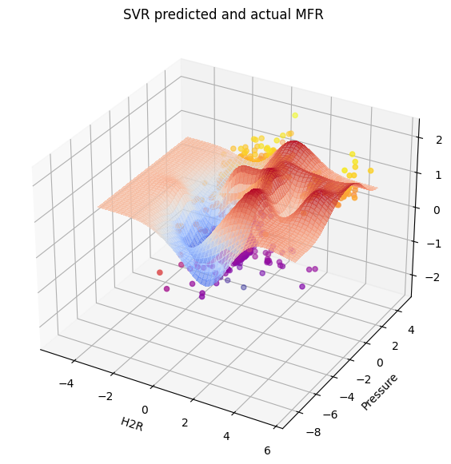
Results 2
Non-linear regression models with average R² scores:
Testing set: 0.76 (Nu Support Vector), 0.73 (K-Neighbors), and 0.76 (Support Vector)
Training set: 0.81 (Nu Support Vector), 0.75 (K-Neighbors), and 0.80 (Support Vector)

Slide 17
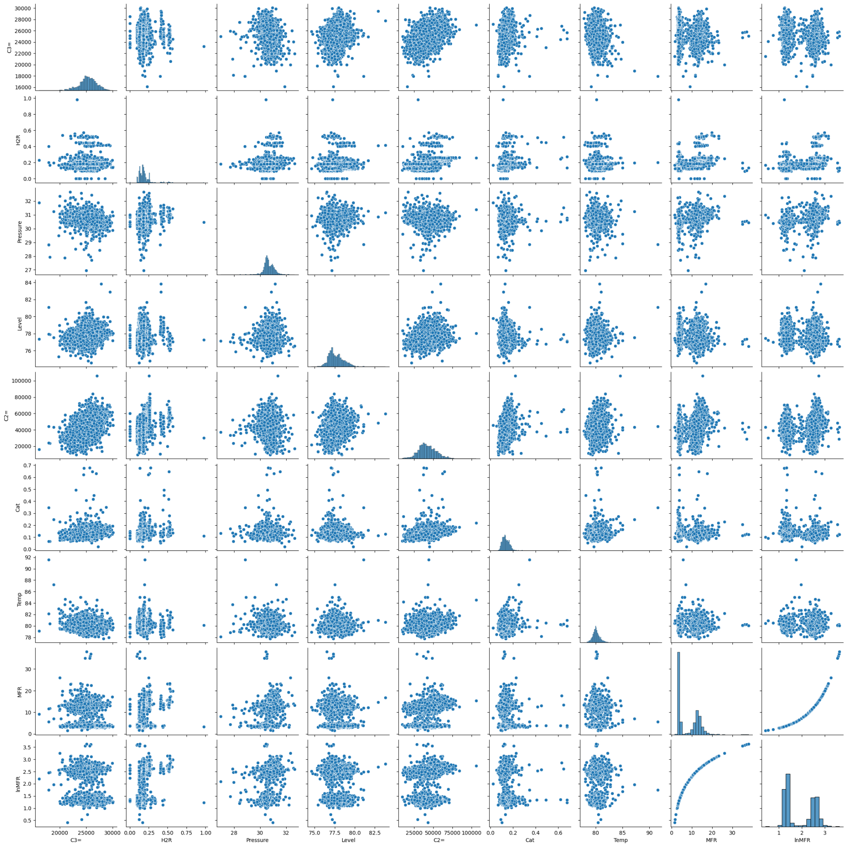
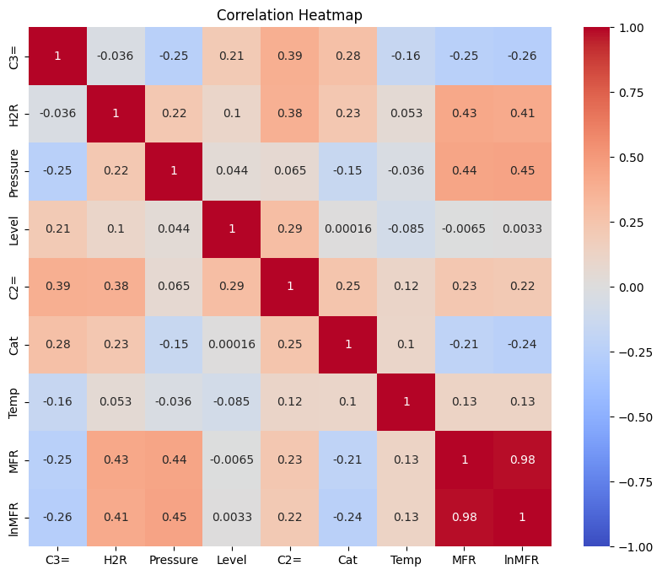
Methodology 3: Exploratory Data Analysis and Preprocessing
Figure: Pairplot of all features
Figure: Correlation Heatmap
Removal of Time feature and Addition of ln(MFR) feature
Perform data analysis using describe method of pandas (count, mean, min, max)
Dropped null values (Length of data before: 2564 | Length of data after: 2484)
Data Visualization: Using pairplot and correlation heatmap

Slide 18
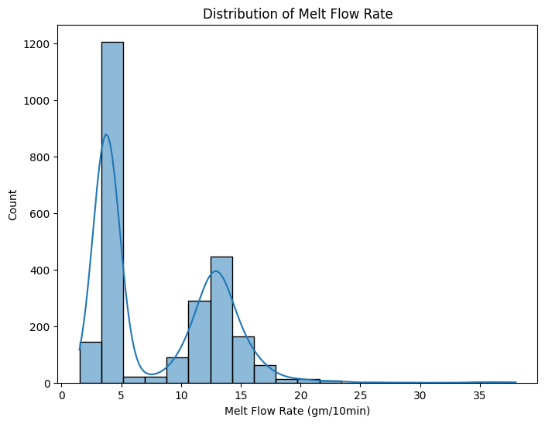
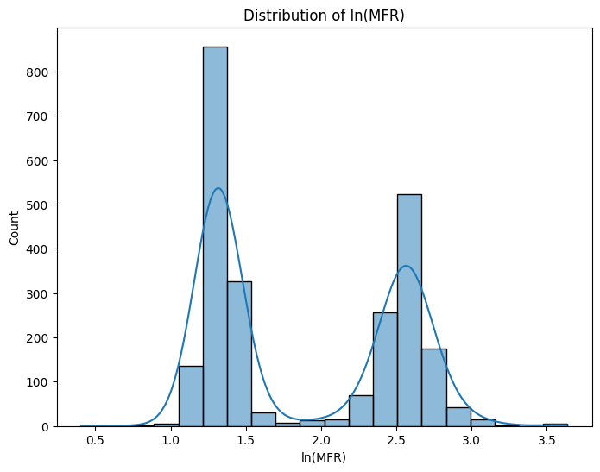
Methodology 3: Exploratory Data Analysis and Preprocessing
Figure: Distribution of Melt Flow Rate (MFR) using Histogram
Figure: Distribution of ln(MFR) using histogram
Some more data visualization: Using histogram

Slide 19
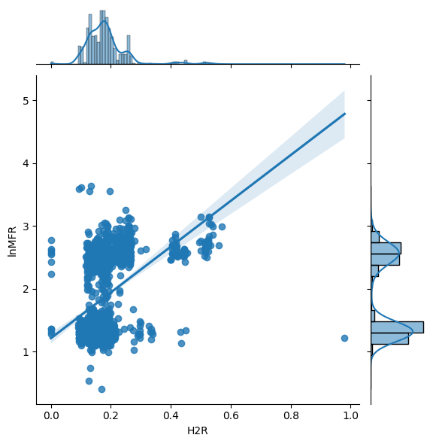
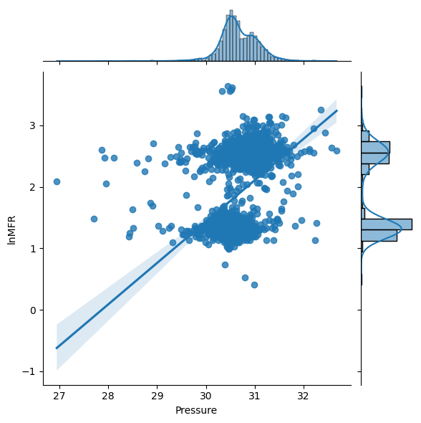
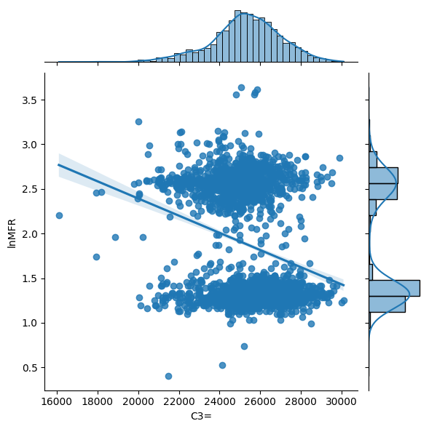
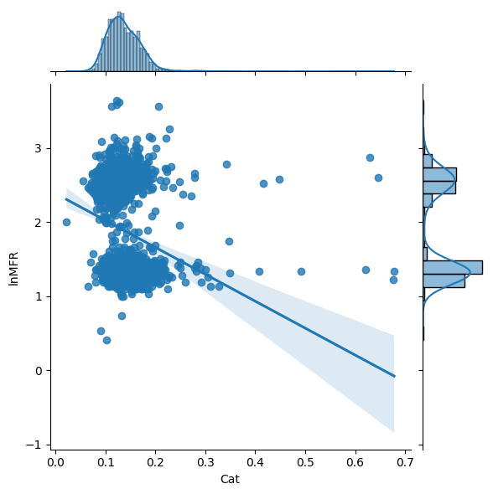
Methodology 3: Exploratory Data Analysis and Preprocessing
Figure: Positive correlation between ln(MFR) and H2R/Pressure
Figure: Negative correlation between ln(MFR) and C3=/Cat
Some more data visualization: Using jointplot to display relationship between 2 variables.

Slide 20
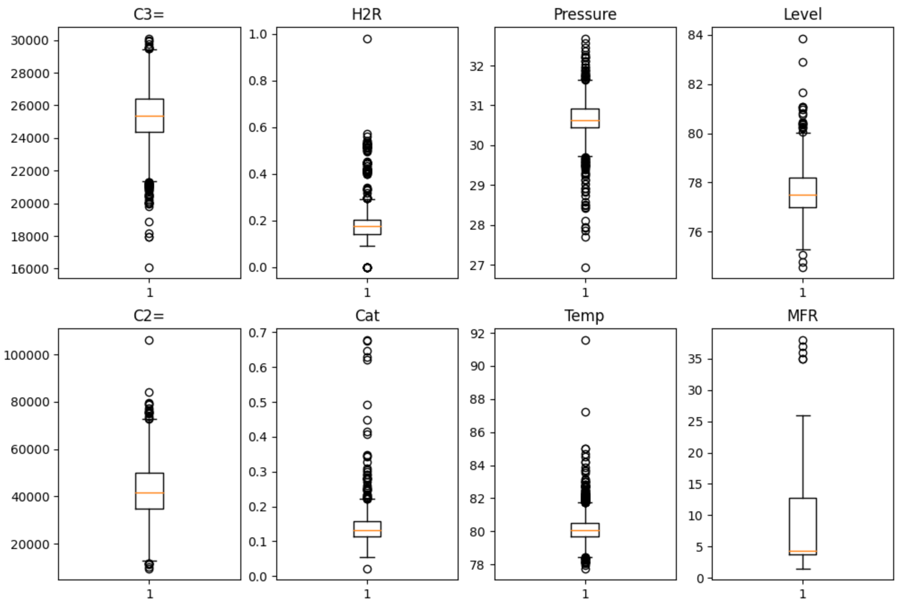
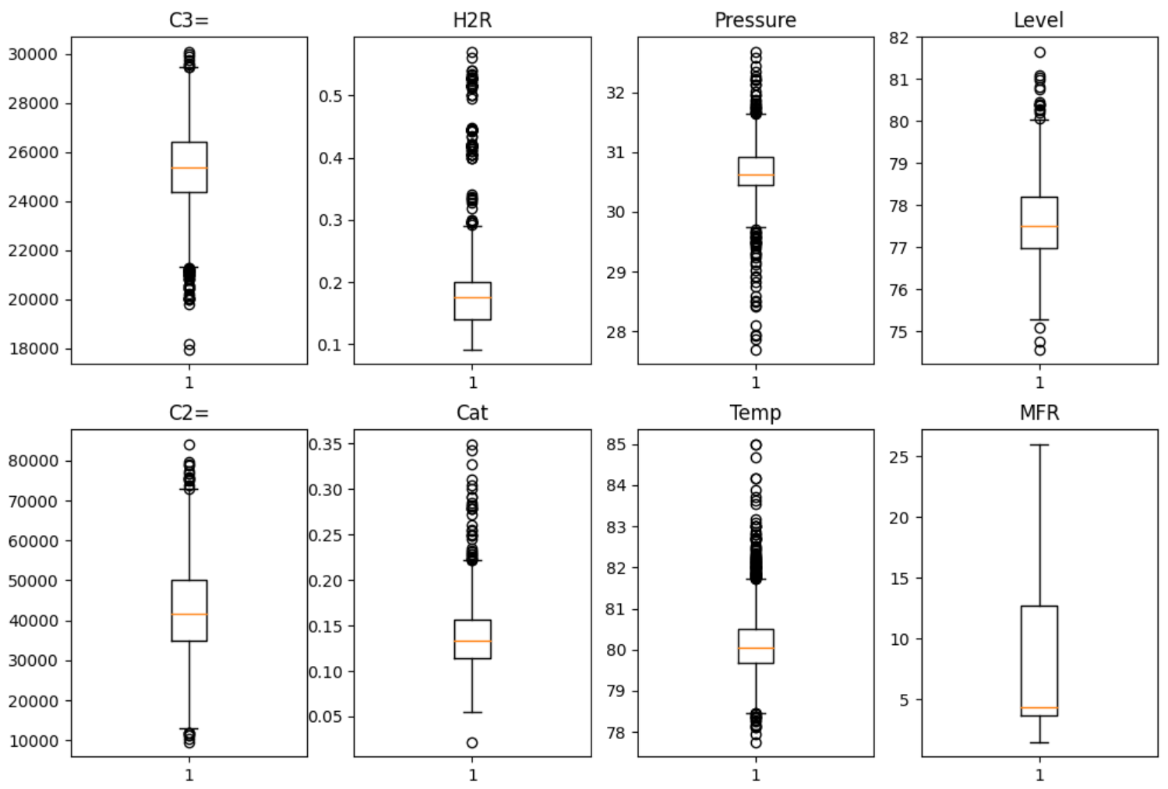
Methodology 3: Detecting Outliers Using Box Plot
Figure: Box plot of all the features before removing outliers
Figure: Box plot of all the features after removing outliers
Outliers removed: ‘C3=’>17000, 0.01<’H2R’<0.7, ‘Pressure’>27.5, ‘Level’<82, ‘C2=’<100000, ‘Cat’<0.4 , ‘Temp’<86, ‘MFR’<30
Length of dataset: before removing outliers: 2484, after removing outliers: 2451 (33 rows removed)

Slide 21
Methodology 3: Feature Engineering/Selection and Further Preprocessing
Delete MFR feature and utilize ln(MFR)
MinMax Scaling:
Convert all features between 0 and 1
Preserves shape of original distribution unlike standard scaler

Slide 22
Methodology 3: Regression Models and Train, Test, Evaluation
Regression models utilized:
Linear
Ridge
Lasso
Polynomial
Train:Test split: 5 fold cross validation (Train size: 1961, Test size: 490)
Evaluation Metric:
R-square (R²)
Mean Squared Error (MSE)
Root Mean Squared Error (RMSE)

Slide 23
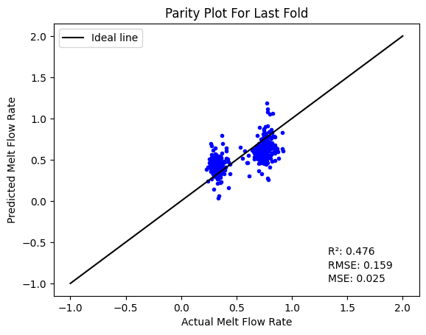
Results 3: Linear Regression
1st fold R²: 0.542, MSE: 0.0227, RMSE: 0.151
2nd fold R²: 0.448, MSE: 0.0220, RMSE: 0.164
3rd fold R²: 0.482, MSE: 0.0250, RMSE: 0.158
4th fold R²: 0.502, MSE: 0.0248, RMSE: 0.157
5th fold R²: 0.476, MSE: 0.0251, RMSE: 0.159
Average score over 5-fold cross-validation:
R²: 0.490
MSE: 0.0249
RMSE: 0.159
Figure: Parity plot of last fold for Linear Regression

Slide 24

Results 3: Ridge Regression
Utilize alpha (regularization strength) of 1.
1st fold R²: 0.538, MSE: 0.0228, RMSE: 0.151
2nd fold R²: 0.452, MSE: 0.0268, RMSE: 0.164
3rd fold R²: 0.484, MSE: 0.0259, RMSE: 0.158
4th fold R²: 0.499, MSE: 0.0249, RMSE: 0.158
5th fold R²: 0.474, MSE: 0.0252, RMSE: 0.159
Average score over 5-fold cross-validation:
R²: 0.490
MSE: 0.0249
RMSE: 0.158
Figure: Parity plot of last fold for Ridge Regression

Slide 25
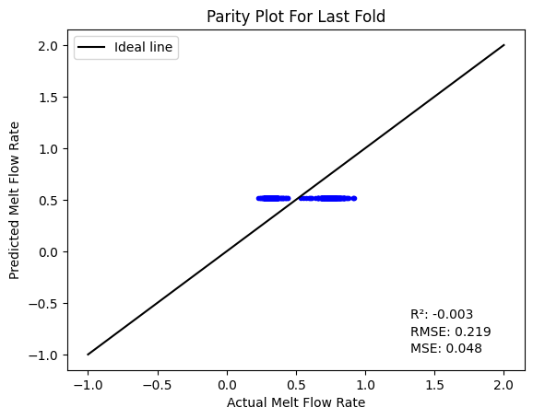
Results 3: Lasso Regression
Utilize alpha (regularization strength) of 1.
1st fold R²: -0.000359, MSE: 0.0496, RMSE: 0.223
2nd fold R²: -0.0495, MSE: 0.0493, RMSE: 0.222
3rd fold R²: -0.00375, MSE: 0.0485, RMSE: 0.220
4th fold R²: -0.00384, MSE: 0.0500, RMSE: 0.224
5th fold R²: -0.00251, MSE: 0.0482, RMSE: 0.219
Average score over 5-fold cross-validation:
R²: -0.00308
MSE: 0.0491
RMSE: 0.221
Figure: Parity plot of last fold by Lasso Regression

Slide 26

Results 3: Polynomial Regression
Utilized polynomial degree of 2.
1st fold R²: 0.637, MSE: 0.0179, RMSE: 0.134
2nd fold R²: 0.556, MSE: 0.0218, RMSE: 0.147
3rd fold R²: 0.599, MSE: 0.0194, RMSE: 0.139
4th fold R²: 0.637, MSE: 0.0181, RMSE: 0.134
5th fold R²: 0.616, MSE: 0.0184, RMSE: 0.136
Average score over 5-fold cross-validation:
R²: 0.609
MSE: 0.0191
RMSE: 0.138
Figure: Parity plot of last fold by Polynomial Regression

Slide 27
Comparison of Models Using 3rd Methodology
Regression Model | Average R² | Average MSE | Average RMSE
Linear | 0.490 | 0.0249 | 0.158
Ridge | 0.490 | 0.0250 | 0.158
Lasso | -0.00308 | 0.0491 | 0.222
Polynomial | 0.609 | 0.0191 | 0.138
Table: Comparison of four regression models using average R², MSE, and RMSE over 5 folds

Slide 28
Analysis and Comparison of Result Sets
Methodology | First | Second | Third
Regression Techniques | Linear | Linear, included some alternatives | Linear, including Ridge and Lasso, and Polynomial
Removed Outliers? | Only those necessary | Yes | Yes
Adjusted for Normalcy? | Yes, using logs | Only MFR | Yes, using min-max scaling

Slide 29
Analysis and Comparison of Result Sets Cont.
Each of the three methodologies demonstrated has its own sets of benefits and detriments.
The first is simple, can be written as a linear equation, and by not removing outliers, may perform better in more extreme scenarios than the linear models which removed outliers. May also impact performance on regular data. Best linear model by R².
The second, having addressed outliers, negates that worry. Also demonstrates non-linear models that produced by far the best results overall.
The third, managing both outliers and normalcy, produced nearly equivalent linear models to the first. However, polynomial regression was the best “simple” method.

Slide 30
Conclusions/Reflection
Having used various techniques, we see that relatively comparable results can be reached in a variety of ways. Various data cleaning techniques can also produce rather significantly different results, and so must be compared to best match the goal of the model.
It is also noted that it is important to recognise the units of the predicted variable, as that impacts methods of comparing different models such as MSE and RMSE.
Future work can expand on what’s been done, both by adding new data, as well as addressing more of the non-linear models such as Support Vector, K-Neighbors, and Nu Support Vector models which outperformed in this analysis other linear and polynomial models. It’s important to again be sure which of these techniques best match the goals of the model.

